Slide 1
Arabic in 10 Minutes
Presented By:
Sindhuula Selvaraju

Slide 2
Facts about Arabic
Classical Arabic originated in the 6th Century
5th most common language in the world after Mandarin, Spanish, English and Hindi
Belongs to the Afroasiatic family
4th largest number of any language family
Six branches: Berber, Chadic, Cushitic, Egyptian, Omotic and Semitic
Arabic is the most widely spoken of these
Modern Standard written language derived from the Quran
Influenced many other languages like Persian, Urdu, Hindi, Spanish, English etc
Arabic has borrowed from Hebrew, Aramaic, Greek, Kurdish etc
Over 30 varieties of colloquial Arabic including Egyptian, Algerian, Saidi etc
Dialects of Arabic divided into
Western(Maghrebi)
Central(Egyptian and Sudanese)
Northern(Mesopotamian)
Peninsular(Yemeni)

Slide 3
Facts about Written Arabic
Words are written from right to left
Numbers are written from left to right
Arabic letters will change form depending on where they’re placed
Derived from Aramaic script and has 28 letters
28 consonants including two semi-vowels
Six vowels
There is no capitalization of letters
Letters are always joined together

Slide 4
Geographical Distribution
353.5 Million total speakers
206 Million Native speakers
246 Million speak Arabic varieties as a second language
100.5 Million casual speakers(not professional)
Official language of Algeria, Bahrain, Chad, Iraq, Israel etc

Slide 5
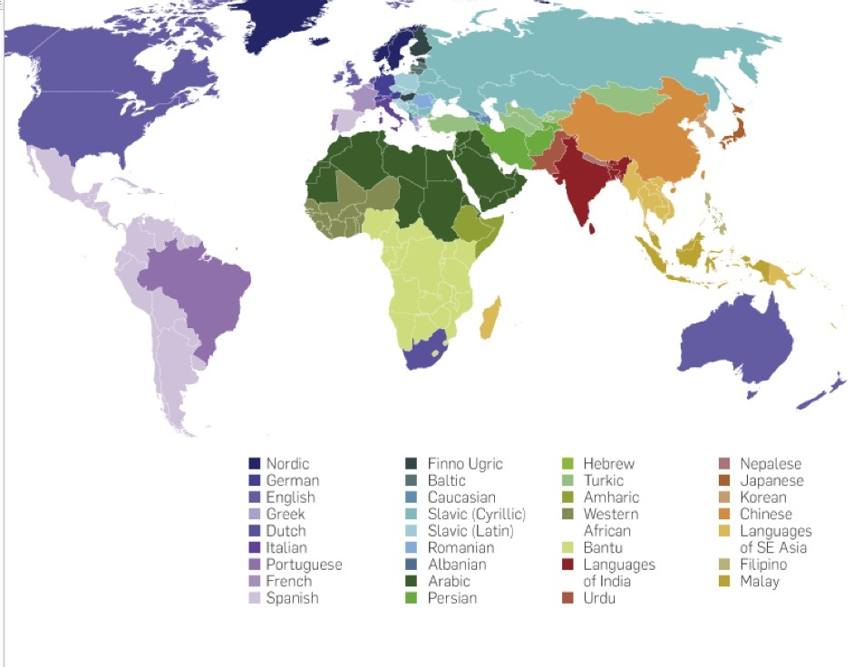
Geographical Distribution

Slide 6
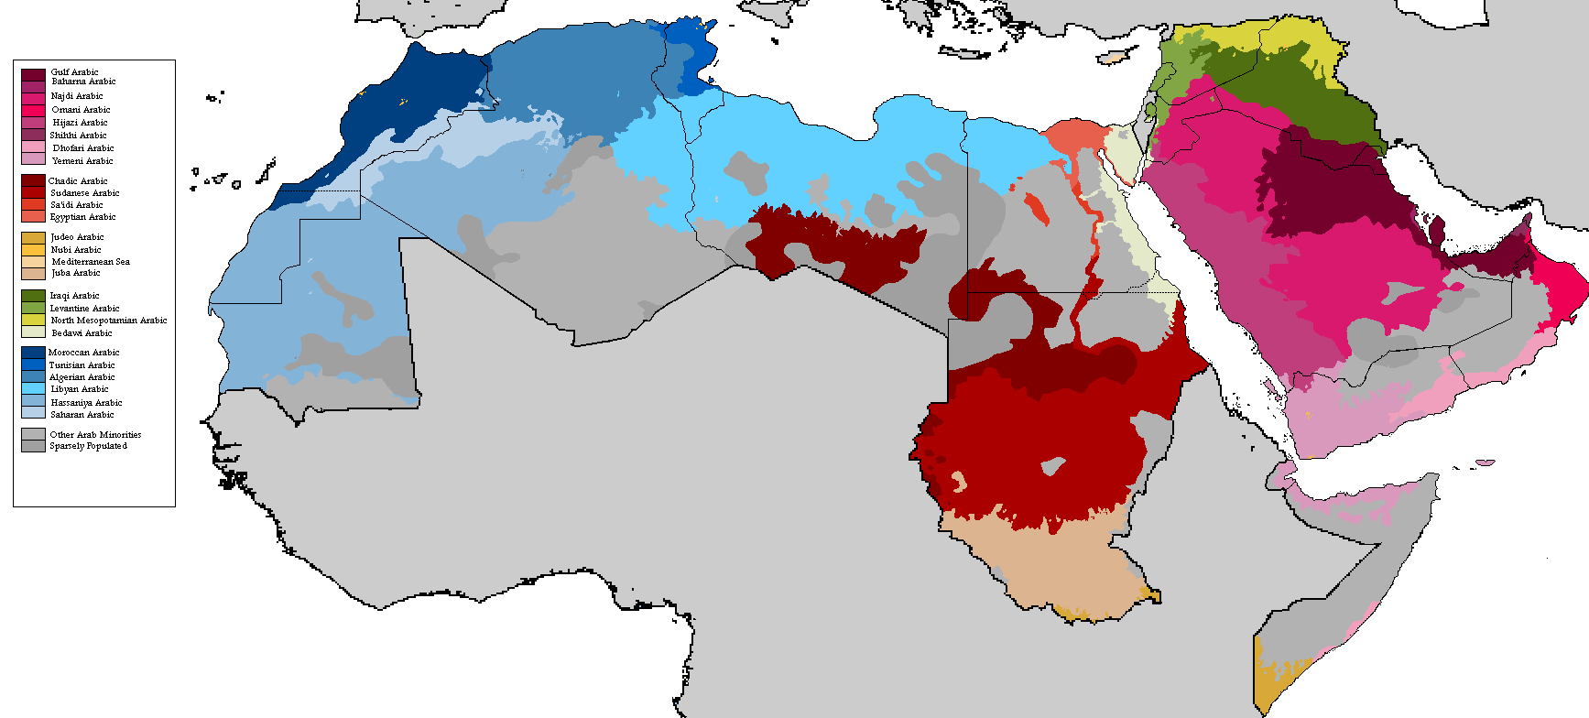
Dialect Distribution

Slide 7
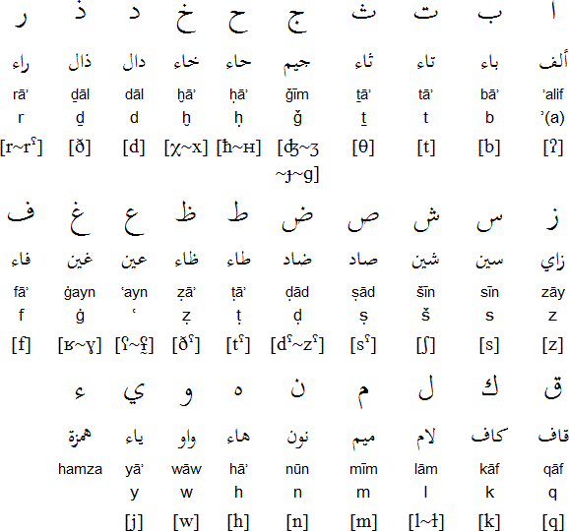
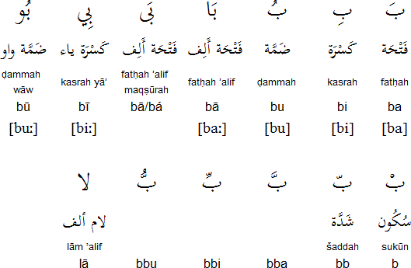
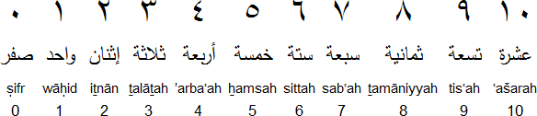
Arabic Script
Vowels
Constants
Numbers

Slide 8
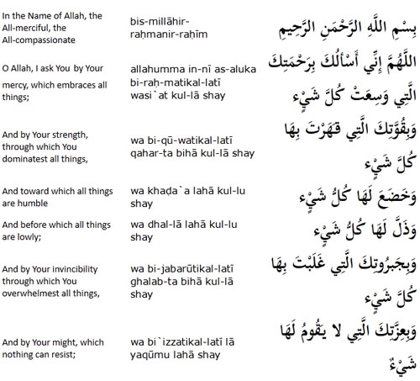
Example

Slide 9
Machine Translations
Hello, This is a presentation for language in 10 minutes and I'm speaking about Arabic
مرحبا، وهذا هو عرض للغة في 10 دقيقة وأنا أتحدث عن اللغة العربية
مرحبا، وهذا هو عرض للغة في 10 دقيقة وأنا أتحدث عن اللغة العربية
Hello, this is the display language in 10 minutes and I'm talking about the Arabic language

Slide 10
Morphology
Words in Arabic are divided into:
اِسْم : includes nouns, pronouns, adjectives, adverbs, etc
فِعْل : verbs
حَرْف: particles, articles, and conjunctions
Person |  | Singular | Dual | Plural
1st |  | anā أنا | naḥnu نحن
2nd | masculine | anta أنت | antumā أنتما | antum أنتم
 | feminine | anti أنت |  | antunna أنتنّ
3rd | masculine | huwa هو | humā هما | hum هم
 | feminine | hiya هي |  | hunna هنّ

Slide 11
Morphology(Nouns)
Morphotactic
Arabic Broken Plurals (templatic)
Stem = Root + Pattern
poss
plural
Stem
article
prep
conj
وكبيوتنا
/wakabiyūtinā/
و + ك + بيوت + نا
wa+ka+buyūt+nā
and+like+houses+our
And like our houses
وللمكتبات
/walilmaktabāt/
و+ل+ال+مكتبة+ات
wa+li+al+maktaba+āt
and+for+the+library+plural
And for the libraries
11

Slide 12
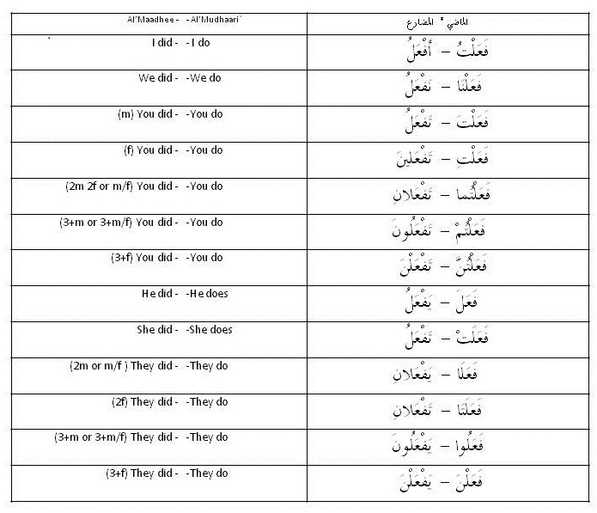
Morphology(Verbs)

Slide 13

Morphology(Prepositions)
Meaning | Independent form | With "... me" | With "... you" (masc. sg.) | With "... him"
"to“ | لـ li- | لي lī | لك laka | له lahu
"in", "with", "by" | بـ bi- | بي bī | بك bika | به bihi
"in" | في fī | فيّ fīya | فيك fīka | فيه fīhi
"to" | إلى ilá | إليّ ilayya | إليك ilayka | إليه ilayhi
"on" | على ‘ alá | عليّ ‘ alayya | عليك ‘ alayka | عليه ‘ alayhi
"with" | مع ma‘a | معي ma‘ī | معك ma‘aka | معه ma‘ahu
"from" | من min | منّي minnī | منك minka | منه minhu
"on", "about" | عن ‘ an | عنّي ‘ annī | عنك ‘ anka | عنه ‘ anhu

Slide 14
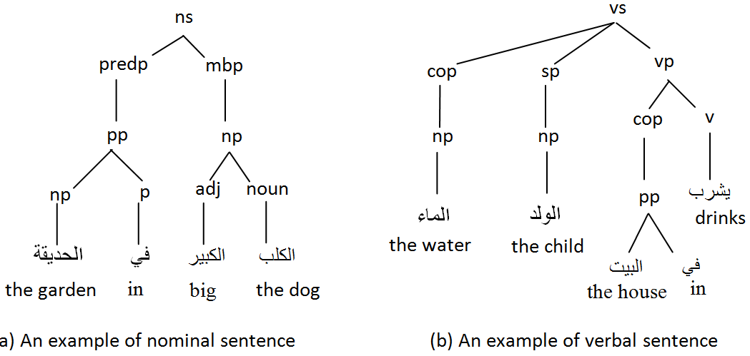
Word Order
Verbal VSO Word Order: Verb before subject before object
Nominal SVO Word Order: Subject before verb before object

Slide 15
Inflection
Particles do not have grammatical roles(don’t become subjects or objects)
Noun group has many varieties of grammatical roles
non-dual demonstrative pronouns (e.g. ذلك، اولئك)
non-dual relative pronouns (e.g. الذي، الذين)
conditionals (e.g. ما، حيثما)
interrogatives (e.g. ما، من)
verbal nouns (e.g. هيهات)
others
Verbs are of 3 categories
ماضي: the perfect tense (e.g. ضَرَبَ)
مضارع: the imperfect tense (e.g. يَضْرِب)
امر حاضر معروف: the second person, active imperative (e.g. اِضْرِبْ)

Slide 16
Computational Effort
Arabic NLP: Introduction to Arabic natural language processing by Nizar Habash
Google Translate incorporated Arabic in April 2006
Processing MSA:
A maximum entropy word aligner for Arabic-English machine translation, Ittycheriah and Roukos, ACL 2005
MADA+TOKAN: A Toolkit for Arabic Tokenization, Diacritization, Morphological Disambiguation, POS Tagging, Stemming and Lemmatization, Habash et al., MEDAR 2009
Arabic preprocessing schemes for statistical machine translation, Habash and Sadat, 2006
Processing dialects:
Parsing Arabic Dialects, Chiang et al. EACL 2006
Morphological Analysis and Disambiguation for Dialectal Arabic, Habash et al. NAACL HLT 2013
CODACT: Towards Identifying Orthographic Variants in Dialectal Arabic, Dasigi and Diab , IJCNLP 2011
Dialectal Arabic to English Machine Translation: Pivoting through Modern Standard Arabic, Salloum and Habash, Proceedings of NAACL-HLT 2013
MT-Archive:
There are more than 200 entries since 2010
Most to do with speech recognition, improving certain aspects of machine translation

Slide 17
Machine Translation

Slide 18
Machine Translation Challenges
Non-vocalization of Arabic words
مهمة can be task or the feminine form of important
Inadequate lexicon
Multiple meanings, connotation, and collocation
مرآز centre, position, rank, status
Deletion
Addition(English to Arabic)
Easier to translate SVO
Gender Translation(no neutral gender)
Tense translation
Prepositions
Read about this in full detail at http://www.mt-archive.info/BCS-2006-Izwaini.pdf

Slide 19
Resources
Wikipedia
Omniglot.com
http://strategyleader.org/articles/arabicpercent.html
https://www.alsintl.com/blog/most-common-languages/
Google images
http://www.linguisticsearchsolutions.com/linguistic-search/linguistic-coverage/
http://sites.middlebury.edu/arabiclinguistics/
http://www.learnarabiconline.com/arabic-morphology-introduction.shtml
https://special.worldofislam.info/Arabic/pdf/Treasures_of_Arabic_Morphology.pdf
http://www.mt-archive.info
http://sites.lsa.umich.edu/collectiveintelligence/wp-content/uploads/sites/176/2015/02/Shquier-CI-2015-Abstract.pdf
http://www.mt-archive.info/BCS-2006-Izwaini.pdf
Some really good friends like Sana Nadeem and Yasra Shakeel

